Slide 1
Types of computing in Distributed Systems

Slide 2
Computing in Distributed Systems
Distributed system is used in performance computation which requires high computing.
Cluster Computing
Grid computing

Slide 3
Cluster computing
Two or more computers work together to solve a problem.
The cluster devices are connected via a fast Local Area Network (LAN).
Each device in the cluster is called a node.
Each node has the same hardware and the same operating system.
A homogenous network in which all the devices are dedicated to work as a single unit.

Slide 4
Cluster computing
Cluster computing was developed due to a variety of reasons such as availability of low-cost microprocessors, high-speed networks, and software for high performance distributed computing.
It is applicable for small business as well as for fast supercomputers. Overall, cluster computing improves performance, and it is cost effective than using a set of individual computers.

Slide 5
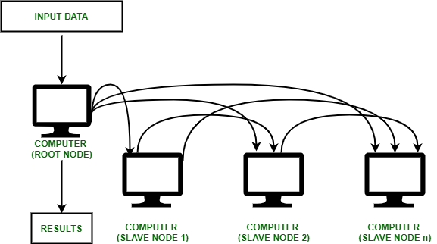
Cluster Computing

Slide 6
Cluster computing
Computer clusters come in a variety of shapes and sizes, including −
Clusters for load balancing: Incoming requests are distributed for resources among several nodes running similar programs or having similar content. This prevents any single node from receiving a disproportionate amount of task. This type of distribution is generally used in a web-hosting environment.
Clusters with high availability (HA): maintain redundant nodes that can act as backup systems in case any failure occurs. Consistent computing services like business activities, complicated databases, customer services like e-websites and network file distribution are provided. They are designed to give uninterrupted data availability to the customers.
Clusters with high performance (HP): They are used to performing functions that need nodes to communicate as they perform their jobs. They are designed to take benefit of the parallel processing power of several nodes.

Slide 7
Applications of Cluster Computing
In many web applications functionalities such as Security, Search Engines, Database servers, web servers, proxy, and email.
It is flexible to allocate works as small data tasks for processing.
Assist and help to solve complex computational problems
Cluster computing can be used in weather modeling
Earthquake, Nuclear, Simulation, and tornado forecast

Slide 8
Grid Computing
Multiple computers work together to solve a problem.
The devices in the cluster have different hardware and operating system.
Therefore, the network in grid computing is heterogeneous.
Grid computing is based on distributed computing with non-interactive workloads.

Slide 9
Grid Computing
We can conclude that grid computing focuses on managing heterogeneous resources connected by a network and ensures that these resources can be fully utilized for computing tasks.
Data grid primarily deals with providing services and infrastructure for distributed data-intensive applications that need to access, transfer and modify massive data sets stored in distributed storage resources.

Slide 10
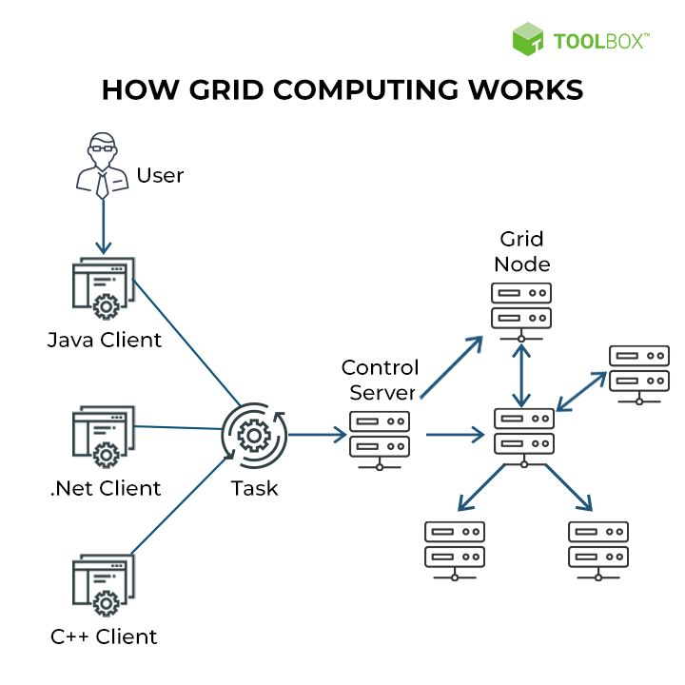
Grid Computing

Slide 11
Grid Computing
In grid computing, the task is divided into several independent subtasks.
Each machine on the grid is assigned with a subtask.
After completing them, the results are sent to the main machine.
Therefore, each device or node in the grid performs a different task.
The devices in grid computing are installed with a special software called middleware.

Slide 12
Difference Between Cluster and Grid Computing Definition
Hardware and OS in Nodes: The nodes in cluster computing have the same hardware and same operating system. The nodes in grid computing have different hardware and various operating systems. This is the main difference between cluster and grid computing.
Task of the Nodes: In cluster computing, each node performs the same task controlled and scheduled by software. In grid computing, each node performs different tasks.
Network Type: While cluster computing is a homogenous network, grid computing is a heterogeneous network.
Location: The clustering devices are located in a single location. However, the devices in grid computing are located in different locations.

Slide 13
Difference Between Cluster and Grid Computing Definition
Method of Connecting the Devices: In cluster computing, the devices are connected through a fast local area network. In grid computing, the devices are connected through a low-speed network or internet.
Resource Handling: In cluster computing, the resources are managed by centralized resource manager. In grid computing, each node has its own resource manager that behaves similarly to an independent entity.
Applications: Cluster computing is used to solve issues in databases or WebLogic Application Servers. Grid computing is used to solve predictive modelling, simulations, Engineering Design, Automation, etc
Both these computing techniques are cost-effective and increase efficiency.

